Slide 1
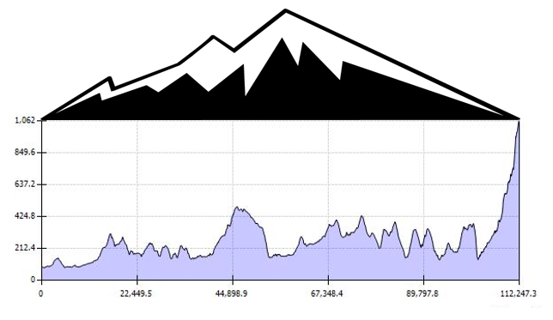



Front of t shirt – front upper right
Back of t shirt - centre
Left sleeve
Right sleeve

Slide 2
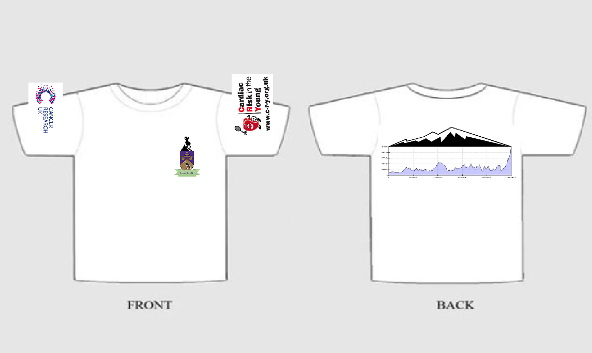

Slide 3
Colours
Bright Baby blue
Bright pink

